Slide 1
Azure Service Fabric
[ Instructor Name ]
[ Instructor E-mail ]

Slide 2
Topics
Introducing Microservices & Azure Service Fabric
Service Fabric Concepts
Developing Service Fabric Applications
Deployments & Upgrades
Notes:
Objective: Discuss the agenda for the deck
Notes:
The deck is broken into 4 sections that discuss:
An Introduction to Azure Service Fabric and the Microservices Architecture Pattern
A discussion of the key Service Fabric concepts
Getting Started with the development tools for Azure Service Fabric
An overview of deployment and upgrade concepts

Slide 3
Introducing Microservices & Azure Service Fabric
Notes:
Objective: This section will provide a high-level introduction to Azure Service Fabric and to the Microservices Architecture pattern.

Slide 4
Microservices Architecture
Microservice Architecture
Monolithic Architecture
An evolution of Service Oriented Architecture
Create a system as a suite of small, independently deployable services
Services communicate across lightweight protocols
Considerations
Services can be scaled to meet their individual needs
Supports use of different technology stacks for different system parts
Process automation is important (DevOps)
Storage
Storage
Storage
Product Catalog
Storage
Storage
Business Logic
Business Logic
1...n
AuthN
Shopping Cart
UI/UX
UI/UX
Notes:
Objective: To provide an initial explanation of what a Microservices architecture entails
Notes: The Microservices architecture is an evolution of the older Service Oriented Architecture (SOA) pattern, building on top of the rapid develop/test/deploy cycles that have arisen due to advances in both technology and project process management.
In a Traditional “Monolithic” solution, a system will often be made up of large self-contained applications which are scaled as a group. Storage is often a single entity – albeit with some redundancy – and is scoped to address the entire set of application needs. Application segmentation usually takes the form of modules, libraries, or other platform artifacts that allow some segregation of implementation, but nonetheless, the application is both deployed and scaled as a single fixed unit.
In a “Microservices Architecture”, the system is deployed as a suite of smaller, independent services which communicate over lightweight protocols such as HTTP or TCP. These smaller units can be developed and deployed independently, including support for using different platforms/languages/technologies to do so. As long as the contracts between the services are enforced (or otherwise managed), different parts of the application can be developed, deployed, and scaled independently of each other. Furthermore, storage is typically scoped just to the service that needs it, offering perhaps more nuanced choices for using different kinds of storage for different parts of the solution.
Of course, with this added flexibility comes some additional responsibility – there are more individual units to deploy and manage. A good DevOps pipeline greatly facilitates the ability for a team to manage the additional complexity involved in the Microservices approach to distributing an application’s functionality.

Slide 5
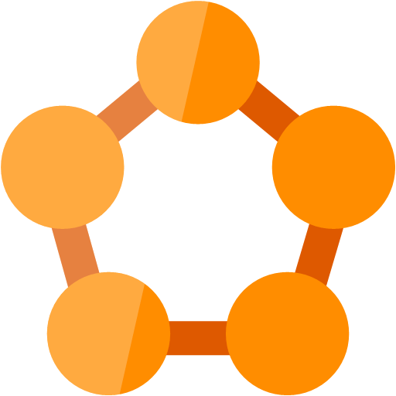
Azure Service Fabric
Can be thought of as an orchestrator of services across a managed cluster of machines
Good for microservices, but not only
Can be run in Azure, on-premises, or in other clouds
Proven platform used by several Microsoft Cloud services, including:
Azure SQL Database
Document DB
Cortana
Microsoft Power BI
Microsoft Intune
Azure Event Hubs
Azure IoT Hub
Skype for Business
Notes:
Objective: To provide a high level description of Azure Service Fabric
Notes: Azure Service Fabric is a platform that manages or orchestrates one or several services across a cluster of machines. As such it is an ideal fit for applications that are designed around a Microservices architecture, though it can also accommodate other application architectures as well. Service Fabric solutions can be deployed into Microsoft Azure, on-premises, or even in other vendors clouds, though there is additional tooling and support when deployed in Microsoft Azure.
As you can see, Service Fabric is not just a tool that is being made available to Azure customers, it is also a key part of the underpinnings of several components of the Microsoft Cloud, including the list shown here, among several others.

Slide 6
Service Fabric Concepts
Notes:
Objective: This section will discuss several key Service Fabric Concepts, including the application and service models.

Slide 7
Service Fabric Concepts
Application
Service
Service
Service
Node
Node
Node
Node
Partitions
Cluster
Notes:
Objective: Present the Core Concepts that make up a Service Fabric Application
Notes: A Service Fabric Application is made up of a collection of Services, where each service id responsible for performing some distinct function. Services are composed of Code, Configuration, and Data, where code is the executable binaries, configuration consists of the service settings that affect its runtime behavior, and data is any arbitrary static data that the service will consume at runtime. Service Fabric supports several different Service models, and can be categorized as being either Stateful Services or Stateless Services (the different service models will be discussed in an upcoming slide.)
At runtime, services are deployed into a Cluster, where a cluster is a scalable collection made up of a set of either physical or virtual machines. Each machine (physical or virtual) that is part of a cluster is called a Node. Service Fabric manages distribution of services across the cluster based on placement criteria identified in the service’s configuration and also on the application’s resource balancing needs.
The configuration for each service will include a partition scheme for that service, as well as instance and/or replica counts. Services can split data and processing across multiple partitions, which are then spread out across the nodes in a cluster. Stateless services have instances, whereas stateful services have replicas. Instances provide availability, in that in the event of a failure of one instance, the other instances continue to function. Replicas keep the state for a service in sync across multiple partitions; should one replica fail, one of the others will take its place and a new replica will be created.

Slide 8
Service Models
Reliable Service & Reliable Actor Services
Leverage Service Fabric’s own programming models
Guest Executable Services
Arbitrary executable packaged in a Service Fabric service
Can be written in any language
Container Services
Networking Naming Service support
Integrate with code, configuration, and data upgrades
Service Fabric manages orchestration and execution management of the executable
Limited integration with the Service Fabric APIs
Instances are not process isolated for each instance, but instead are created as objects (higher density on host.)
Containers can either be Reliable Services or Guest Containers
Supports Docker Containers (Linux) and Windows Server Containers
Currently in Preview
Notes:
Objective: To introduce the available models for service development in Azure Service Fabric
Notes: There are 3 general categories of services that Azure Service Fabric can manage – “Reliable Service & Reliable Actor Applications”, “Guest Executable Applications”, and “Container Applications”.
Reliable Service & Reliable Actor Services are built on top of .NET SDK frameworks provided by Azure Service Fabric. As such, they have programmatic access to service and service-fabric functionality. This includes accessing the Service Fabric Naming Service (resolve service instance URL by name) and integration with the instance lifecycle events, among others. Additionally, service instances are create as objects under the management of Service Fabric, instead of individual processes, which allows for higher density within the host cluster. These models will be discussed more in detail shortly.
Guest Executable Services allow you to create a service that hosts an arbitrary executable. This executable can be written in any language you choose, and Service Fabric will take care of execution management tasks like ensuring the application is running and other orchestration tasks. Because guest executables are not built on top of the Service Fabric APIs, they have limited access internally to the Service Fabric functionality.
Container Services can be thought of as an application-within-an-application, in that multiple services can be placed within a container. This includes supporting Reliable Services which include Stateless Services within a container (Linux only), Stateful Services within a container (Windows only), or arbitrary guest executables within a container.
Additional Information:
https://docs.microsoft.com/en-us/azure/service-fabric/service-fabric-deploy-existing-app
https://docs.microsoft.com/en-us/azure/service-fabric/service-fabric-containers-overview

Slide 9
Reliable Services
Stateless Service
Typically used for Web API front-ends or background workers that look at external queues
Stateful Service
Used when state must be consistent and present for the service to function
Leverages the Reliable Collections
No state is maintained within the service, though external state storage can certainly be used
ReliableQueue, ReliableDictionary
State is kept locally, but replicated for high-availability, backed with disk storage for durability, and transactional.
Notes:
Objective: To introduce the Reliable Service programming models available in Azure Service Fabric
Notes: Azure Service Fabric supports 2 different Reliable Service programming models – Stateless Service and Stateful Service (along with the Stateful Actor framework, to be discussed shortly.)
Stateless services (as the name implies) do not include provisions for handling in-process state. Note that a stateless service *can* maintain state, it is just that the programming framework does not provide any tooling to that end. The state must be persisted to some external storage mechanism (like a database), and is not dissimilar from a typical stateless web application design.
Stateful services include access to in-process state. The stateful information is both replicated and persisted to disk. Additionally, the stateful collections that are managed by Stateful Services also support transactions to ensure consistent operations.
Additional Information:
https://docs.microsoft.com/en-us/azure/service-fabric/service-fabric-reliable-services-introduction

Slide 10
Partitioning – Stateless Services
Stateless Services
In a stateless environment, scalability and availability generally achieved by adding instances
Place an instance of the service in each Node
Add Nodes to scale out
Node 1
I
Node 2
Node 3
I
I
Node 4
Node 5
I
I
Notes:
Objective: To introduce the concept and impact of Partitioning in a Stateless Service
Notes: Let’s take a look at the different Reliable Services and see how Partitioning allows Service Fabric to provide reliability and scalability. Since Stateless Services have no inherent state, the reliability and scalability come simply from numbers. Reliability exists because if one instance goes down, there are still other instances present to handle the load. Scalability is present because adding (or removing) nodes allows the service to handle additional (or reduced) volume.
Here we have a Stateless Service running in 3 Partitions distributed across 3 Nodes. (Animation) If we add two more Nodes to the service, Service Fabric simply also create two additional service instances.

Slide 11
Partitioning – Stateful Services
For stateful services
Services are Distributed for scalability
Service state is Replicated for availability
Distribute primary replicas across the nodes in the cluster and also place secondary replicas
Add Nodes, then rebalance to scale out
Stateful Services
Node 1
P1
S3
S2
S4
S5
Node 2
Node 3
P5
S3
S4
P3
S1
S5
P2
S1
P4
S2
Node 4
Node 5
Notes:
Objective: To introduce the concept and impact of Partitioning in a Stateful Service
Notes: Providing scalability and reliability is a little trickier in a Stateful Service. In order to do so, we need to maintain distributed replicas of the state in each partition, keeping track of a primary Partition and a number of Secondary Partitions.
Reliability exists because if Service Fabric is aware of a single node going down, it can rebalance using the Secondary partition replicas located on other nodes, promoting them to Primary nodes as necessary and creating new additional Secondary replicas.
Scalability is present as long as the number of Nodes approaches the number of Partitions (when scaling up.) Once you have more Nodes than Partitions, the additional Nodes do not generally contribute to expanded capacity in the system.
Here we have a Stateful Service running in 5 Partitions with 3 Replicas per partition, distributed across 3 Nodes. (Animation) If we add two more Nodes to the service, Service Fabric rebalances the existing partitions, easing the load on the original 3 Nodes.

Slide 12
Reliable Actors
Implementation of the Virtual Actor pattern
Ideal when the application involves many (thousands) of small isolated units of logic & state
Built on top of Stateful Reliable Services
Actors are instantiated upon reference and collected upon inactivity
State Management can be used during reference to “restore” an actor
Actor actions are turn-based (single-threaded) per instance.
Supports Timers and Reminders
Also supports Events
Notes:
Objective: To introduce the Reliable Actors framework available in Azure Service Fabric development
Notes: The Reliable Actors framework is a Virtual Actor implementation that is built on top of stateful Reliable Services.
In a Virtual Actor implementation, an Actor is a unit of both logic and state that is managed by the framework. Client applications reference an actor by a unique ID. The framework manages the allocation and lifetime of individual actor instances, including “resurrecting” an actor instance which has gone dormant due to a period of inactivity.
Actor instances provide a turn-based, single-threaded access model, making it possible to not have to deal with concurrency issues in a distributed programming model. With this single-threaded behavior, Timers and Reminders both offer support for running code after a function call has completed. Timers and reminders differ mainly in that Timers cannot “re-awaken” a time-expired actor, whereas Reminders will continue to execute, “waking” a dormant actor instance as necessary, until the actor unregisters the reminder or the actor is explicitly deleted.
Finally, actors also support raising events back to the calling application. Because of the nature of distributed programming, these events are not strictly guaranteed to reach their listeners (if reliable messaging is required, a queue-based or similar solution is recommended.)
Additional Information:
https://docs.microsoft.com/en-us/azure/service-fabric/service-fabric-reliable-actors-introduction

Slide 13
Developing Service Fabric Applications
Windows Setup
Notes:
Objective: Introduces the concepts related to developing Service Fabric projects with Visual Studio 2017 on Windows.
For Linux, see https://docs.microsoft.com/en-us/azure/service-fabric/service-fabric-get-started-linux
For Mac OS, see https://docs.microsoft.com/en-us/azure/service-fabric/service-fabric-get-started-mac

Slide 14
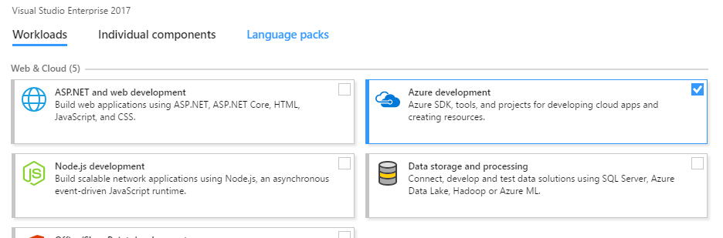
Installation
The Microsoft Azure Service Fabric SDK is included in the “Azure development” Workload in the Visual Studio 2017 installer
Notes:
Objective: Show what needs to be done to install the Service Fabric SDK and development tools in Visual Studio 2017
Notes: The Visual Studio 2017 features a different take on the previous Visual Studio installers, where “Features” are replaced by “Workloads.” To install the Service Fabric tools in Visual Studio 2017, you select the “Azure development” workload from the “Web & Cloud” section in the installer.
For Visual Studio 2015, see https://docs.microsoft.com/en-us/azure/service-fabric/service-fabric-get-started
Note – in Visual Studio 2015, the Azure Service Fabric SDK and tools were deployed and updated via the Web Platform Installer. In Visual Studio 2017, these components have been moved to be part of the installation and update process for Visual Studio itself.

Slide 15
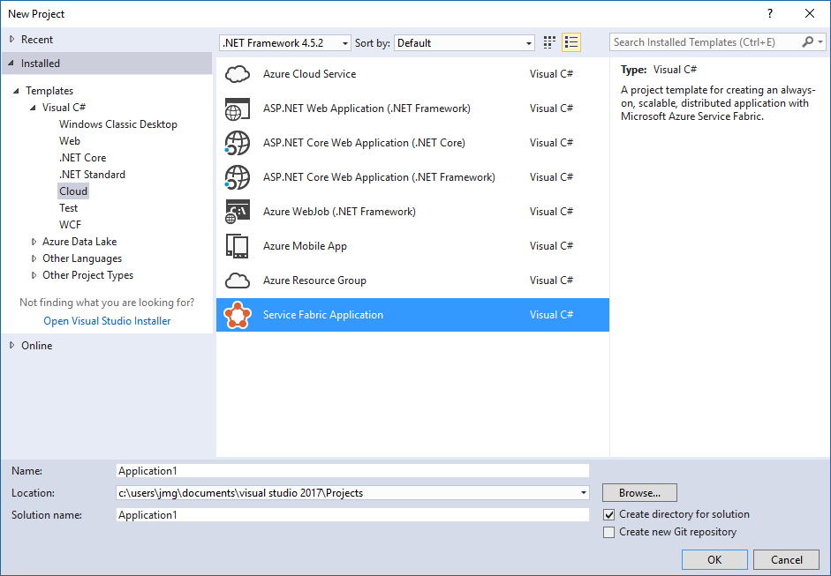
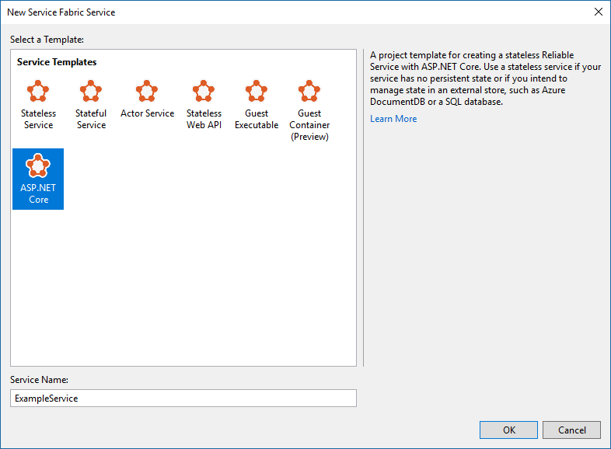
Creating a Project
Create a new project by selecting the “Service Fabric Application” template from either the Cloud project node.
Choose your desired service type template
Notes:
Objective: To show how to start a new Azure Service Fabric project in Visual Studio 2017
Notes: To create a new Azure Service Fabric project in Visual Studio 2017, select File/New Project, then select the “Service Fabric Application” option from the “Cloud” node. Notice the various Service project types that can be created:
Stateless & Stateful Reliable Services
An Actor Service
A Stateless Reliable Service provisioned with ASP.NET WebAPI endpoints
A Guest Executable Service
A Container Service (in Preview)
A Stateless Reliable Service provisioned with ASP.NET Core (this project can also be used for web projects that include user interface elements.)

Slide 16
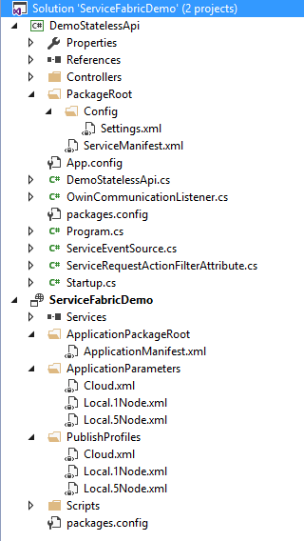
Solution Structure
Application Project
The Services node lists the service projects that make up the Application
Includes an Application Manifest that describes the services that make up the Application
Includes application publishing profiles, and per-profile settings.
Service Project(s)
Includes a Service Manifest that describes the Service characteristics
Includes the Service code and configuration
Notes:
Objective: To explain the folder and content layout of a typical Service Fabric solution
Notes: When you create a new Service Fabric project in Visual Studio, your solution will be set up with at least 2 projects, each containing several important files.
Each solution will include one Application Project (ServiceFabricDemo in the illustration)
This project includes the configuration for the overall Application managed by Service Fabric (an application can include one or more services)
The services node lists the services that have been included in this application – you can open this node and add or remove services
The key file in this project is the Application Manifest file. This file identifies both the application type and the application version, and specifies the services that will make up the application as well as how the applications will be laid out in the Service Fabric cluster.
The project also includes one or more Publishing Profiles which enable setting different application configurations for different deployment environments (for example, local deployment vs a cloud-based test cluster vs a cloud –based production environment.)
Each solution will include one or more Service Projects (DemoStatelessApi in the illustration)
This project includes the configuration for the overall Application managed by Service Fabric (an application can include one or more services)
These projects will each include their own Service Manifest files, with the Service Manifest describing the service type, version, and other configuration options
This project will also include the service’s code and configuration files

Slide 17
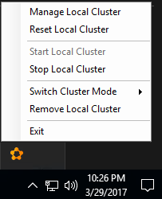
Service Fabric Local Cluster
Installed as part of the Service Fabric SDK
Provides a local debug & test environment
Can provision a 1-node or 5-node cluster
Not an emulator or a simulator
Can be managed via the Windows System Tray application or via PowerShell scripts.
Visual Studio is configured to work with the Local Cluster
Notes:
Objective: To discuss the Service Fabric Local Cluster for local development
Notes: The Service Fabric Local Cluster is included as part of the Azure Service Fabric SDK, and is meant to provide you with a complete local development and testing environment in order to accelerate your developing and deploying Service Fabric applications. The Local Cluster allows you to stand up either a 1-node or 5-node clusters – 1 node clusters are quicker to provision and deploy, but 5-node clusters are closer to real-world deployments.
It’s important to note that this isn’t an emulator or simulator; the Local Cluster runs the same Service Fabric runtime that you will use in your production deployments.
You can manage the Local Cluster with the Local Cluster Manager app that will be present in your Windows System Tray after you install the Service Fabric SDK, or you can use PowerShell scripts to manage the local cluster. Visual Studio “knows” about the Local Cluster and is set so that when you start the debugger, the application will be built, packaged, and deployed to the Local Cluster.

Slide 18
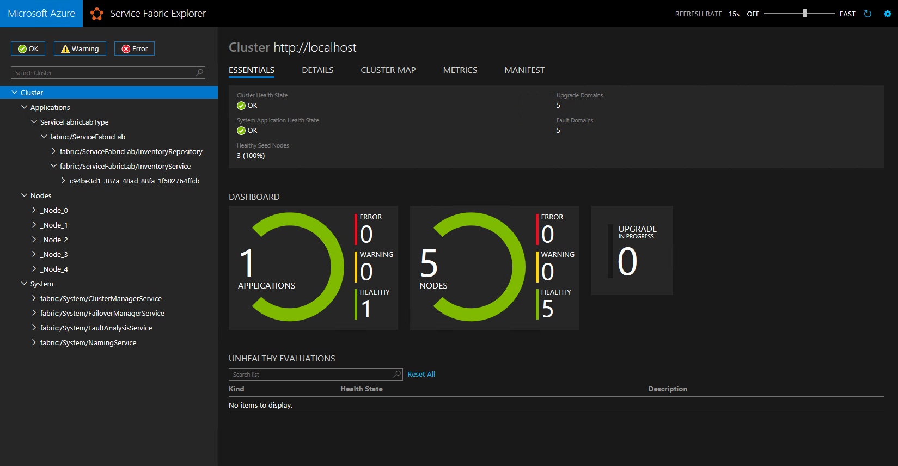
Service Fabric Explorer
Notes:
Objective: To briefly introduce the Service Fabric Explorer tool
Notes: Service Fabric deployments include the Service Fabric Explorer. This is a web-based tool that helps you see and manage the status of your cluster. You can use it to:
See an overview of your cluster health and overall cluster information
See and manage your deployed applications & services
View and manage the nodes in your cluster

Slide 19
Deployments & Upgrades
Notes:
Objective: This section will discuss the options for scaling VM’s (VM sizes and storage) and also the concepts of reliability via Availability Sets

Slide 20
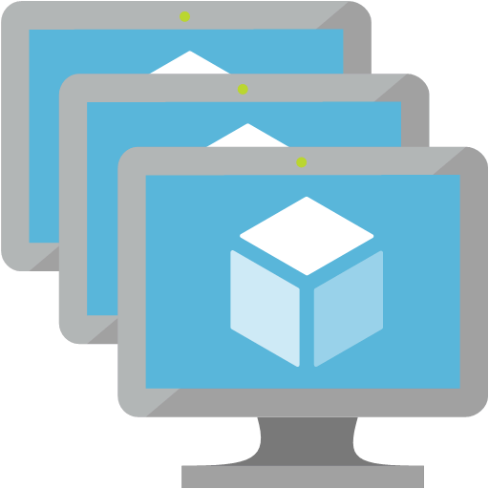
Deploying in Azure
Service Fabric Applications are deployed in Azure into a Virtual Machine Cluster in a Virtual Machine Scale Set (VMSS)
Clusters can be created on VMs running Windows Server 2012 R2, Windows Server 2016, or Linux Ubuntu 16.04 (in preview)
Clusters networking can be configured via Azure VNets, Subnets, Public IP Addresses, and internal and/or external load balancing
Can be managed with Azure ARM templates,
Auto-scaling support is provided by Azure VMSS
Management is via a combination of Azure tools and Service Fabric tools
Notes:
Objective: Describes the concept related to deploying a Service Fabric application in Azure
Notes: In Microsoft Azure, Service Fabric applications are deployed over Virtual Machine (VM) Scale Sets. VM Scale Sets provide infrastructure for scaling workloads across multiple VM’s, as well as mechanisms for cluster management, scaling, and reliability. You can choose the size (and cost) of the VM’s that you application requires, and you can segment different service types to different collections of VM’s, grouped and isolated by subnets within an Azure Virtual Network (VNet), as well as choose to choose to use public-facing or internal-only load-balancing.
Management of a Service Fabric Cluster in Azure is split across the Azure tooling - including the Azure Portal, command-line interfaces, and management APIs – as well as through the Service Fabric tooling via its management APIs tools such as the Service Fabric Explorer.

Slide 21
Application Deployments
Two types of deployments in Service Fabric – Full and Upgrade
In a Full Deployment, the entire application is torn down (if already present) and then a new application instance is deployed.
Upgrade Deployments
Service Fabric supports rolling upgrades to maintain uptime
Service Fabric monitors application health during the upgrade. If the system violates the application health policy, the upgrade is rolled back.
Several modes govern the automation and health-check behavior during an upgrade.
Notes:
Objective: Describes the concept related to Service Fabric Application Upgrades
Notes: There are two models for deploying applications to Service Fabric – Full Deployments and Upgrade Deployments.
Full Deployments completely tear down an existing application and push up a new instance. Any state held by the Service Fabric partitions will be lost, and users are likely to experience downtime during this kind of deployment
Upgrade Deployments use a concept known as Upgrade Domains, in which nodes in the cluster are partitioned into subsets and the upgrade is performed in a series of stages in order to ensure availability. Service Fabric will monitor the health of the system during the upgrade, and if the system health becomes degraded, the upgrade will be rolled back. There are actually 3 upgrade modes – Monitored Mode upgrades perform the upgrade one Upgrade Domain at a time, moving on to the next section only when the previous one has passed all of its health checks. Unmonitored-Auto upgrades merely skip the health checks. Finally, Unmonitored-Manual upgrades require you to upgrade each Upgrade Domain yourself. Note that in order to support rolling upgrades, both versions must be forward and backward compatible (since both versions of the code will co-exist for a time)
More information about upgrades: https://docs.microsoft.com/en-us/azure/service-fabric/service-fabric-application-upgrade

